Slide 1




NEXT GEN EMPLOYABILITY PROGRAM
Creating a future-ready workforce
Team Members:
College Name
SRM TRP College
Student Name :ROHITH G
Student ID :au814721104046

Slide 2

CAPSTONE PROJECT SHOWCASE
Project Title
Notes Sharing Web Application using Django Framework
Abstract | Problem Statement | Project Overview | Proposed Solution | Technology Used | Modelling & Results | Conclusion

Slide 3
Abstract
The web application which I propossed aims to facilitate file sharing between students and teachers in an educational setting.This web application is Built using the Django framework, the application will provide a user-friendly interface for uploading, downloading, and managing files. Users will be able to create accounts, join specific groups (e.g., classes or departments), and share files within these groups. The application will prioritize security and privacy, ensuring that files are accessible only to authorized users. Overall, the goal is to streamline the file-sharing process and enhance collaboration within educational communities.
Source :

Slide 4
Problem Statement
In traditional educational environments, sharing files between students and teachers can be inefficient and cumbersome. Students often need to submit assignments or access resources, while teachers need to distribute materials and provide feedback. However, existing methods, such as email or physical submissions, lack organization and can lead to confusion or lost files.To address these challenges, this project aims to develop a web application that enables seamless file sharing between students and teachers. The application will provide a centralized platform for uploading, downloading, and managing files, enhancing collaboration and efficiency within educational communities.
Source :

Slide 5
Project Overview
The project involves developing a web application using Django to facilitate file sharing between students and teachers. The application will provide a user-friendly interface for uploading, downloading, and managing files, with features tailored to the needs of educational environments.Key Features:User Authentication: Students and teachers can create accounts and log in to the system.File Upload and Download: Users can upload files to share with others and download files shared by others.Group Creation and Management: Users can create groups (e.g., classes or departments) and share files within these groups.Access Control: Files are accessible only to authorized users, ensuring security and privacy.Notifications: Users receive notifications for new file uploads, comments, or other relevant activities.Search Functionality: Users can search for files based on keywords, tags, or other criteria.User Profile: Users can view and manage their profile information, including uploaded
Source :

Slide 6
Proposed Solution
The solution which I proposed is to develop a web application using Django that provides a centralized platform for students and teachers to share files. The application will have the following key components:User Management: Users (students and teachers) will be able to create accounts, log in, and manage their profiles. User authentication will ensure that only authorized users can access the system.File Management: Users will be able to upload files to the system, organize them into folders, and download files shared by others. The application will support various file formats, including documents, images, and videos.Group Management: Users can create or join groups (e.g., classes, departments) and share files within these groups. Group administrators can manage group memberships and permissions.Access Control: Files will be accessible only to authorized group members, ensuring security and privacy. Administrators can set permissions to control who can view, upload, or delete files within a group.Notifications: Users will receive notifications for new file uploads, comments, or other relevant activities within their groups. This will help keep users informed and engaged with the platform.Search Functionality: Users can search for files based on keywords, tags, or other criteria, making it easy to find relevant materials quickly.Responsive Design: The application will have a responsive design, ensuring that it is accessible and usable on a variety of devices, including desktops, laptops, tablets, and smartphones.Overall, the proposed solution aims to provide a user-friendly and efficient platform for students and teachers to share files, enhancing collaboration and communication within educational communities.
.

Slide 7


Technology Used
Front-end
Back-end
Source :

Slide 8
Modelling & Results
In this web page which I created For the students and teacher there is an login and sign up page this will be the landing page of this webapp and there are some validation process such as "user name" ,"password" and after the login there comes home page where students loged in can see and download the files shared bythe teachers and when the teacher logs in he/she will have options to upload a file when the user name and password does not matches web page shows no access When there is some error it shows 404 page not found
Source :

Slide 9
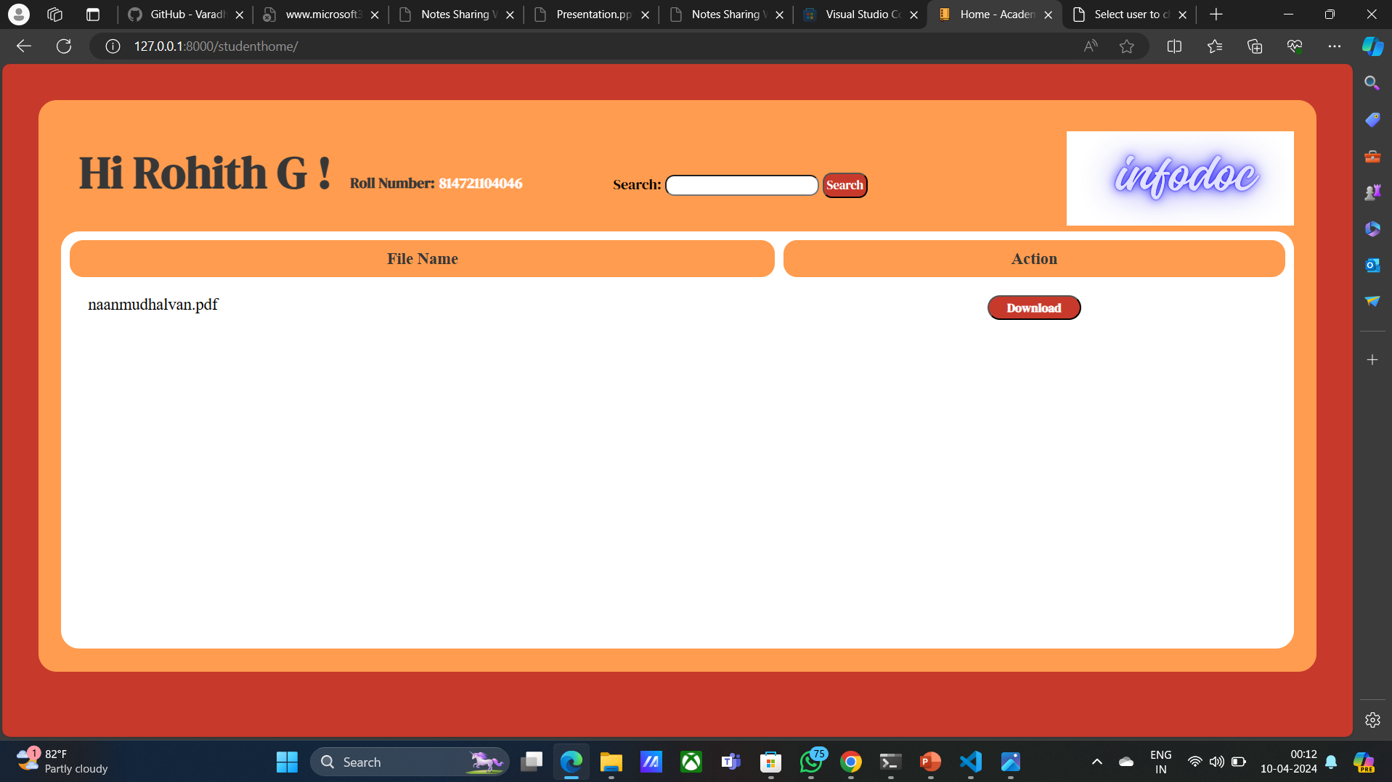
Homepage

Slide 10
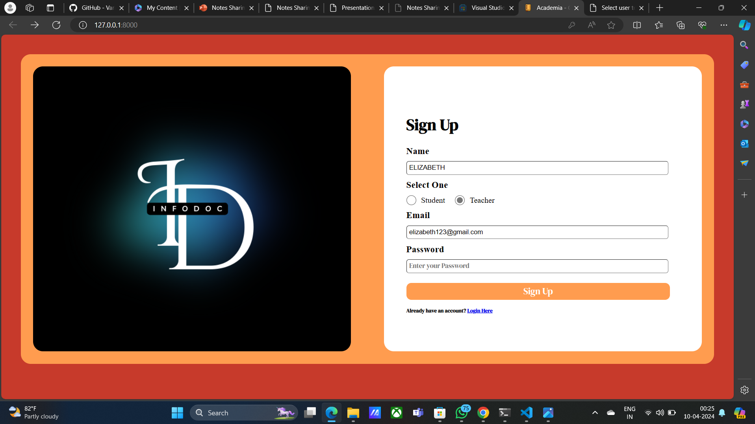
Sign up page

Slide 11
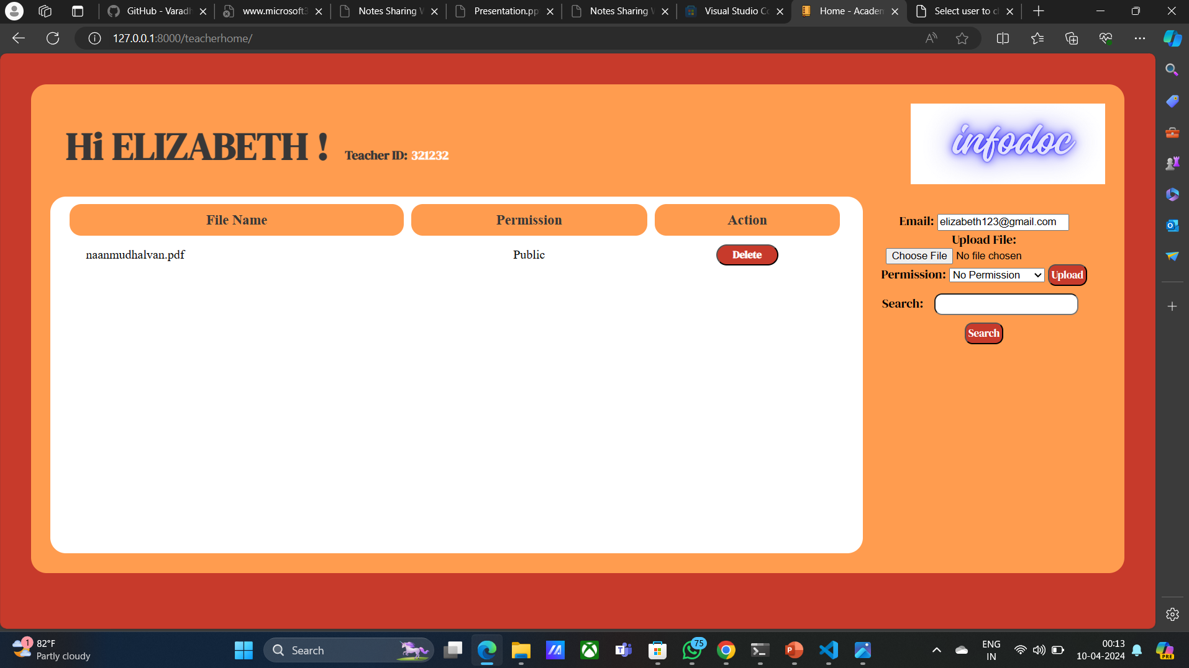
Teachers home page

Slide 12
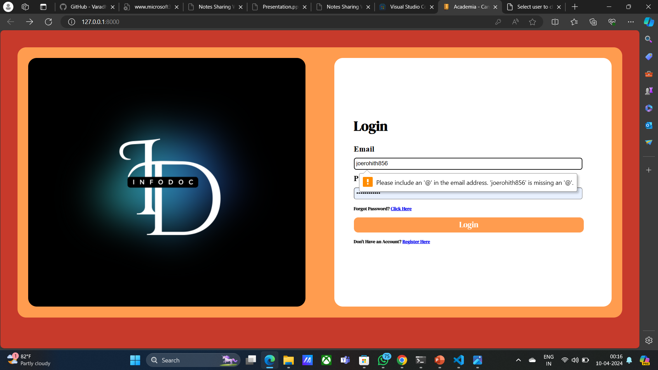
Login page

Slide 13
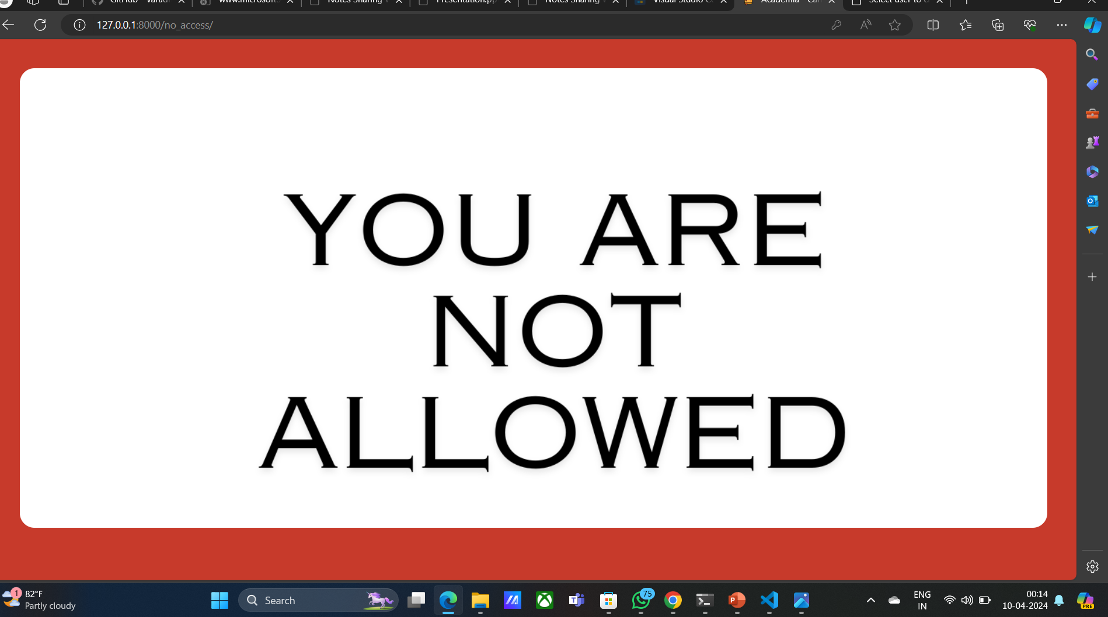
No access

Slide 14
Future Enhancements:
Real-time Collaboration: Implement features for real-time collaboration on documents, such as simultaneous editing and commenting.Advanced Search: Enhance the search functionality with filters, sorting options, and the ability to search within file contents.Integration with Learning Management Systems (LMS): Integrate the application with popular LMS platforms to streamline file sharing within existing educational workflows.File Versioning: Implement version control for files, allowing users to track changes and revert to previous versions if needed.Integration with Cloud Storage: Enable users to link their cloud storage accounts (e.g., Google Drive, Dropbox) for seamless file access and sharing.Analytics and Reporting: Provide analytics and reporting features to track file usage, user activity, and engagement metrics.Mobile App: Develop a mobile app for iOS and Android devices to allow users to access and share files on the go.Enhanced Security Features: Implement additional security measures, such as encryption, to protect files and user data.User Feedback System: Include a feedback system to gather input from users and continuously improve the application based on their suggestions.Integration with Online Learning Tools: Integrate with online learning tools (e.g., quizzes, forums) to provide a comprehensive educational platform.These enhancements will further enhance the functionality and usability of the file-sharing application, making it an even more valuable tool for students and teachers in educational environments.

Slide 15
Conclusion
The development of a web application for file sharing between students and teachers using Django offers a valuable solution to enhance collaboration and efficiency in educational settings. By providing a centralized platform for uploading, downloading, and managing files, the application streamlines the file-sharing process and improves organization.Key features such as user authentication, group management, access control, notifications, and search functionality contribute to a user-friendly experience. Future enhancements like real-time collaboration, advanced search, and integration with learning management systems will further enhance the application's utility and user engagement.Overall, the proposed solution addresses the challenges associated with traditional file-sharing methods in educational environments and provides a robust platform for students and teachers to share files securely and efficiently.
Source :

Slide 16
Thank You!
Notes:
Thank You !!

